Slide 1
Programming with OpenGL
Part 2: Complete Programs
Ed Angel
Professor of Emeritus of Computer Science
University of New Mexico

Slide 2
Objectives
Build a complete first program
  Introduce shaders
  Introduce a standard program structure
Simple viewing
  Two-dimensional viewing as a special case of three-dimensional viewing
Initialization steps and program structure
Angel and Shreiner: Interactive Computer Graphics 7E © Addison-Wesley 2015

Slide 3
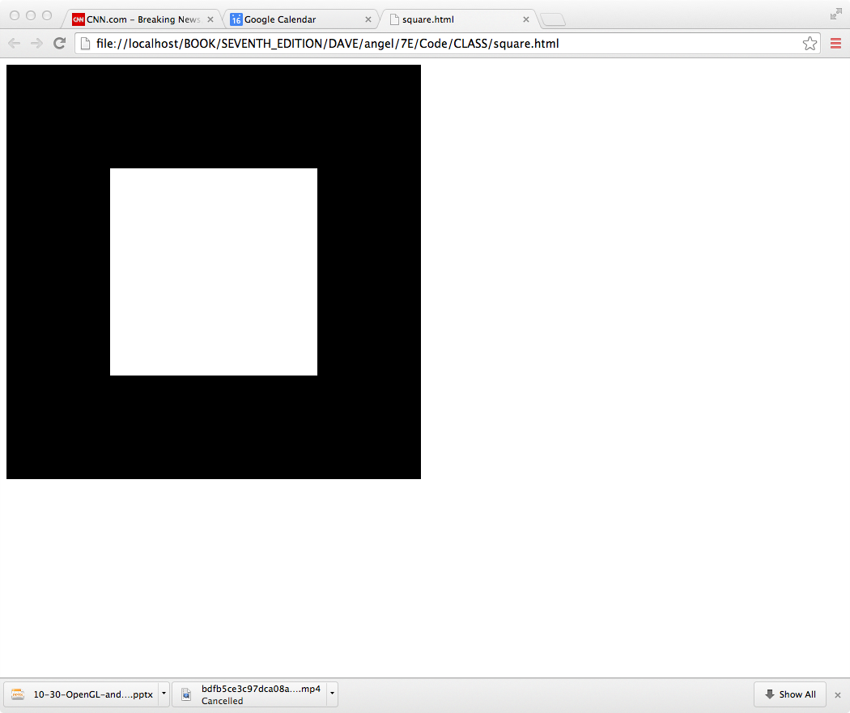
Square Program
Angel and Shreiner: Interactive Computer Graphics 7E © Addison-Wesley 2015

Slide 4
WebGL
Five steps
  Describe page (HTML file)
    request WebGL Canvas
    read in necessary files
  Define shaders (HTML file)
    could be done with a separate file (browser dependent)
  Compute or specify data (JS file)
  Send data to GPU (JS file)
  Render data (JS file)
Angel and Shreiner: Interactive Computer Graphics 7E © Addison-Wesley 2015

Slide 5
square.html
<!DOCTYPE html>
<html>
<head>
<script id="vertex-shader" type="x-shader/x-vertex">
attribute vec4 vPosition;
void main()
{
gl_Position = vPosition;
}
</script>
<script id="fragment-shader" type="x-shader/x-fragment">
precision mediump float;
void main()
{
gl_FragColor = vec4( 1.0, 1.0, 1.0, 1.0 );
}
</script>
Angel and Shreiner: Interactive Computer Graphics 7E © Addison-Wesley 2015

Slide 6
Shaders
We assign names to the shaders that we can use in the JS file
These are trivial pass-through (do nothing) shaders that which set the two required built-in variables
  gl_Position
  gl_FragColor
Note both shaders are full programs
Note vector type vec2
Must set precision in fragment shader
Angel and Shreiner: Interactive Computer Graphics 7E © Addison-Wesley 2015

Slide 7
square.html (cont)
<script type="text/javascript" src="../Common/webgl-utils.js"></script>
<script type="text/javascript" src="../Common/initShaders.js"></script>
<script type="text/javascript" src="../Common/MV.js"></script>
<script type="text/javascript" src="square.js"></script>
</head>
<body>
<canvas id="gl-canvas" width="512" height="512">
Oops ... your browser doesn't support the HTML5 canvas element
</canvas>
</body>
</html>
Angel and Shreiner: Interactive Computer Graphics 7E © Addison-Wesley 2015

Slide 8
Files
../Common/webgl-utils.js: Standard utilities for setting up WebGL context in Common directory on website
../Common/initShaders.js: contains JS and WebGL code for reading, compiling and linking the shaders
../Common/MV.js: our matrix-vector package
square.js: the application file
Angel and Shreiner: Interactive Computer Graphics 7E © Addison-Wesley 2015

Slide 9
square.js
var gl;
var points;
window.onload = function init(){
  var canvas = document.getElementById( "gl-canvas" );
gl = WebGLUtils.setupWebGL( canvas );
if ( !gl ) { alert( "WebGL isn't available" );
}
// Four Vertices
var vertices = [
vec2( -0.5, -0.5 ),
vec2( -0.5, 0.5 ),
vec2( 0.5, 0.5 ),
vec2( 0.5, -0.5)
];
Angel and Shreiner: Interactive Computer Graphics 7E © Addison-Wesley 2015

Slide 10
Notes
onload: determines where to start execution when all code is loaded
canvas gets WebGL context from HTML file
vertices use vec2 type in MV.js
JS array is not the same as a C or Java array
  object with methods
  vertices.length // 4
Values in clip coordinates
Angel and Shreiner: Interactive Computer Graphics 7E © Addison-Wesley 2015

Slide 11
square.js (cont)
// Configure WebGL
gl.viewport( 0, 0, canvas.width, canvas.height );
gl.clearColor( 0.0, 0.0, 0.0, 1.0 );
// Load shaders and initialize attribute buffers
var program = initShaders( gl, "vertex-shader", "fragment-shader" );
gl.useProgram( program );
// Load the data into the GPU
var bufferId = gl.createBuffer();
gl.bindBuffer( gl.ARRAY_BUFFER, bufferId );
gl.bufferData( gl.ARRAY_BUFFER, flatten(vertices), gl.STATIC_DRAW );
// Associate out shader variables with our data buffer
var vPosition = gl.getAttribLocation( program, "vPosition" );
gl.vertexAttribPointer( vPosition, 2, gl.FLOAT, false, 0, 0 );
gl.enableVertexAttribArray( vPosition );
Angel and Shreiner: Interactive Computer Graphics 7E © Addison-Wesley 2015

Slide 12
Notes
initShaders used to load, compile and link shaders to form a program object
Load data onto GPU by creating a vertex buffer object on the GPU
  Note use of flatten() to convert JS array to an array of float32’s
Finally we must connect variable in program with variable in shader
  need name, type, location in buffer
Angel and Shreiner: Interactive Computer Graphics 7E © Addison-Wesley 2015

Slide 13
square.js (cont)
render();
};
function render() {
gl.clear( gl.COLOR_BUFFER_BIT );
gl.drawArrays( gl.TRIANGLE_FAN, 0, 4 );
}
1
2
3
0
Angel and Shreiner: Interactive Computer Graphics 7E © Addison-Wesley 2015

Slide 14
Triangles, Fans or Strips
gl.drawArrays( gl.TRIANGLES, 0, 6 ); // 0, 1, 2, 0, 2, 3
gl.drawArrays( gl.TRIANGLE_FAN, 0, 4 ); // 0, 1 , 2, 3
1
2
1
2
0
3
0
3
gl.drawArrays( gl.TRIANGLE_STRIP, 0, 4 ); // 0, 1, 3, 2
Angel and Shreiner: Interactive Computer Graphics 7E © Addison-Wesley 2015

